Slide 1
Office Hours
January 2023

Slide 2
Forward-Looking Statement
Statements regarding our product development initiatives, including new products and future product upgrades, updates or enhancements represent our current intentions, but may be modified, delayed or abandoned without prior notice and there is no assurance that such offering, upgrades, updates or functionality will become available unless and until they have been made generally available to our customers.

Slide 3
Agenda for Today (January 9, 2023)
What is happening in 2023?
Anthology Events
Ally activities (Roadmaps, feedback opportunities)
Office Hours Q&A with Chris, Ivan and the Ally team
Roadmap questions around upcoming features
Issues
General questions and chat

Slide 4
What is happening in 2023?
Upcoming events and product activities

Slide 5
Fix Your Content Day 2023
May 18, 2023
Global Accessibility Awareness Day
*More info coming soon

Slide 6
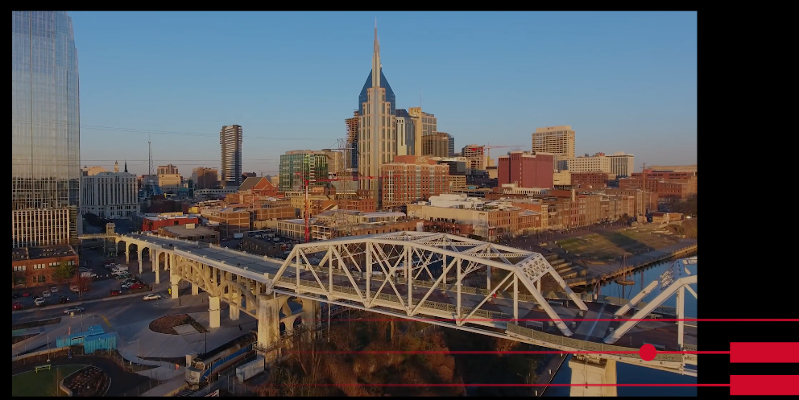
Anthology Together 2023
Open registration at https://www2.anthology.com/together

Slide 7
Surveys
1. Product Feedback
Will be announced in the User Group
Get feedback upon existing capabilities, features and services.
2. New Features
Will be announced in the Release Notes
Get feedback and identify improvements on new features

Slide 8
Detailed Roadmap Sessions
We will be doing Quarterly roadmap sessions apart from these Office Hours.
Announcements will be made through the User Group.
Finalizing dates and times for this Quarter (more to come soon)

Slide 9
Office Hours Q&A
Roadmap questions, issues, general questions and chat

Slide 10
Question 1
Is the use of the WYSIWYG included in the Ally Usage Reports for instructor usage?
Answer: Yes! Within the Usage Reports WYSIWYG content is identified with a file type of ”html-fragment” in the raw data tab. This is factored into the Instructor Feedback Launches and Feedback Weekly tabs.

Slide 11
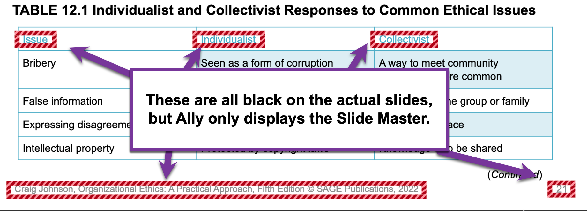
Question 2
There have been a number of known issues with things in PowerPoint including table headers, Smart Art and super/subscript text that are dependent on Libre Office. Some of these have been outstanding for a long time, so how does Ally handle and/or justify this?

Slide 12
Libre Office Planned Updates
Upgrading our Libre Office version this month
Reviewing known issues before and after upgrade

Slide 13
Question 3
In the 2021 Ally Roadmap we saw the following updates listed. What are the plans for these?
Support audio alternative format for documents > 100,000 characters
Automatically create playlist based on heading structure
Highlight text with audio alternative format

Slide 14
Audio Alternative Format
Planning and Prioritizing for 2023
Breaking the 100,000 limit
Playlist based on heading structure
Longer Term Backlog
Highlight text with Audio Alternative Format

Slide 15
Question 4
When can we expect to see less “Guidance Coming Soon” messages? Are you adding guidance here?
And especially for D2L Brightspace, what is the latest on this conversation between Ally and D2L regarding the HTML/WYSIWYG content?

Slide 16
Next Up for Guidance
More Guidance for HTML files
Insufficient contrast
Heading order
Images missing description
Guidance for Password protected files
Guidance for OCRed PDF

Slide 17
A Deeper Look at D2L HTML Guidance
There are 3 levels to D2L HTML content that determine how Ally can best apply guidance:
Brightspace Content Areas and New Experiences
Uploaded HTML vs WYSIWYG
(How Brightspace handles this)
”Guidance Coming Soon” missing guidance in Ally

Slide 18
Next Steps for Brightspace and Ally
Review and prioritize LMS specific considerations and blockers (in progress jointly between Ally and D2L)
Improve the Guidance Coming Soon message within Ally
Released with 2.5.1 - Add the configurable Help link to the Guidance Coming Soon screen to allow instructors to get to other resources in the meantime
Update the language for instructors (in progress)
Release available HTML guidance flows and continue to iterate going forward (in progress)

Slide 19
General Questions?

Slide 20
Next Office Hours – Mon 13 Feb
Please submit your Feb questions via MS Form - https://forms.office.com/r/2dLEMaSM3z
Office Hours will be 2nd Monday of the month.

